Slide 1

BREAST CANCER DETECTION AND CLASSIFICATION
G.H.Raisoni College Of Engineering and Management Wagholi,pune
Presented By-
Chaure Karina_29
Deo Minal_30
Patil Aditi_31
Guided By-
Prof.Anita Mahajan

Slide 2
Outline
Objectives
Abstract
Data Set
Methodology
Results
Applications
Conclusion
References

Slide 3
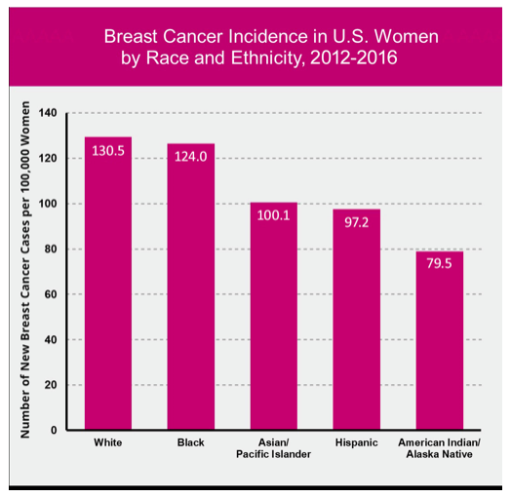
Statistics on Breast Cancer
https://ww5.komen.org/BreastCancer/Statistics.html

Slide 4
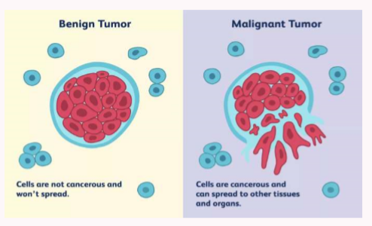
Abstract
An abnormal, uncontrolled cell growth arising in the breast tissue
Breast cancer is the second leading cause of death in women
Breast cancer primarily effects women but about 1 percent of all cases effect men
One third of women with breast cancer die from breast cancer
Malignant Tumor: Cancerous
Benign Tumor: Not-Cancerous

Slide 5
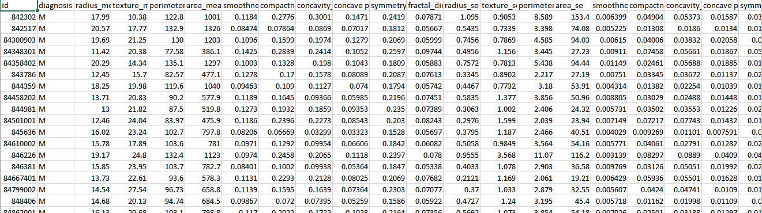
Data Set of the Breast Cancer
Breast Cancer data of 570 women was obtained from the UC Irvine Machine Learning Repository.
URL to access data:
https://archive.ics.uci.edu/ml/datasets/breast+cancer+wisconsin+(original)

Slide 6
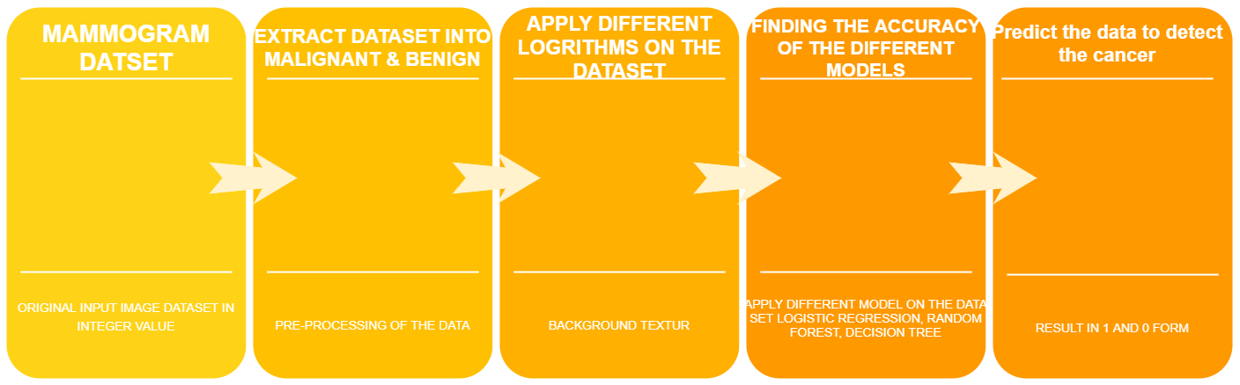
Algorithm of the Project

Slide 7
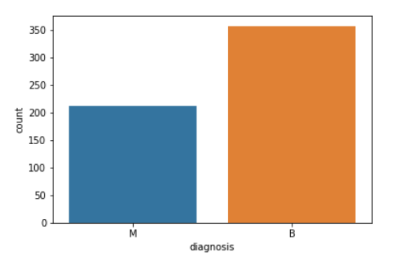
Steps of the Algorithm

Slide 8
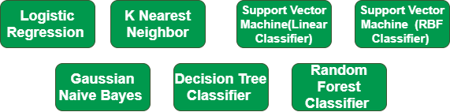
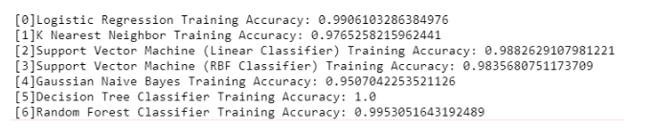
Different Models Used in Algorithm

Slide 9
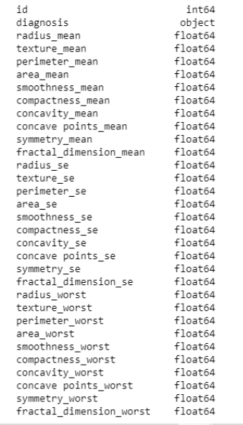
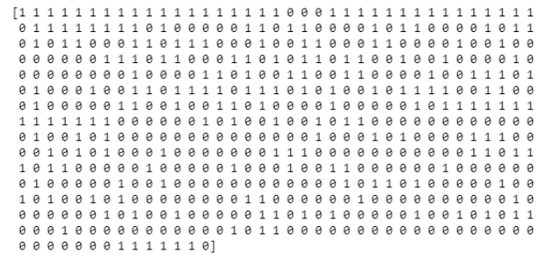
Results

Slide 10
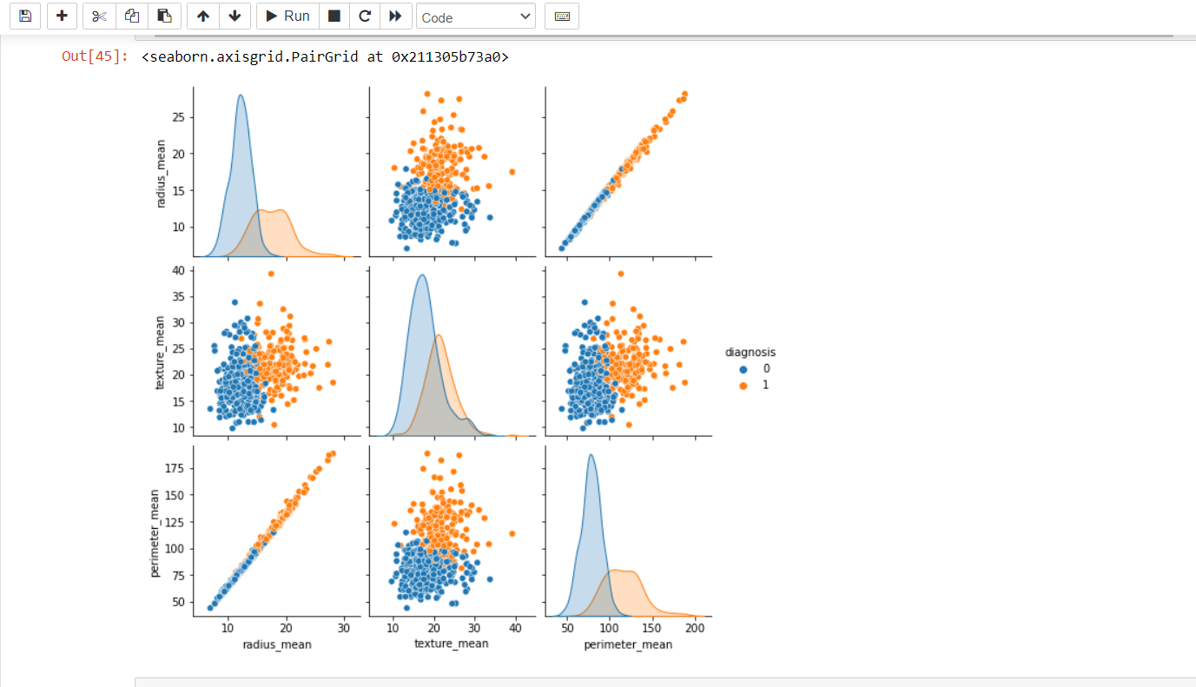

Slide 11
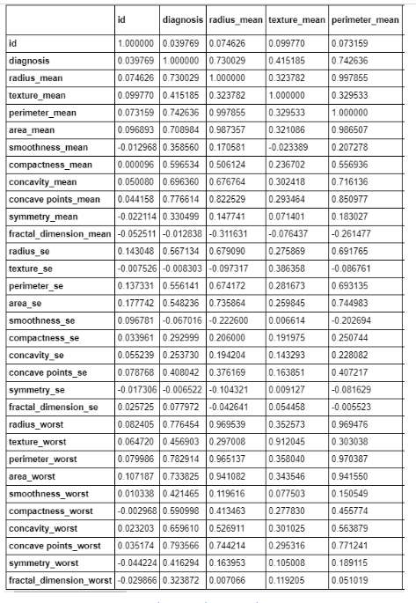

Slide 12
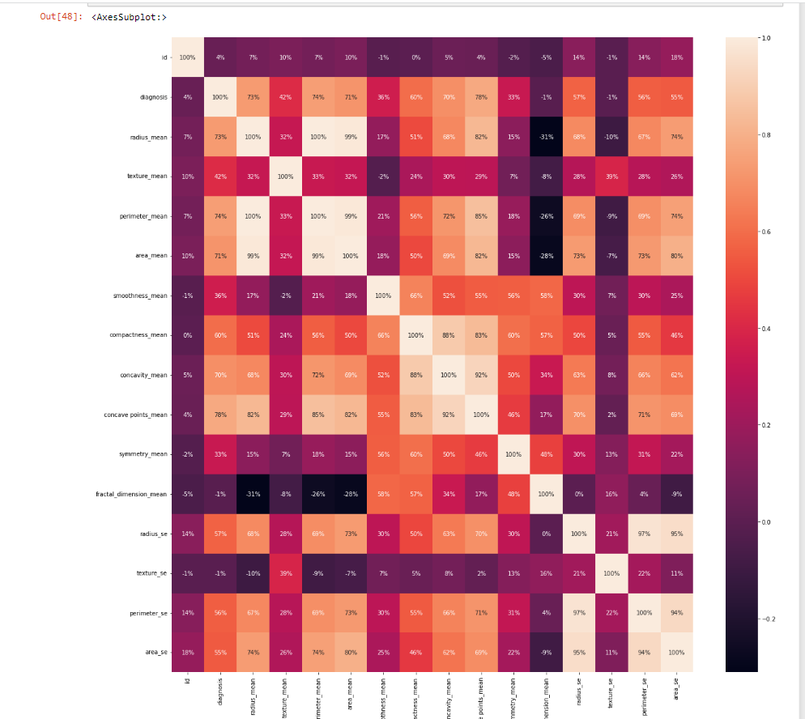

Slide 13
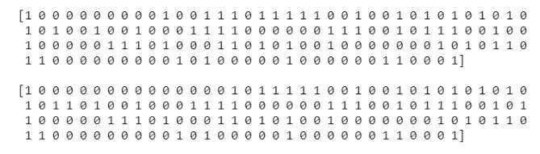

Slide 14
Applications
It can used to predict the Breast Cancer
It can be used to classify the Breast Cancer

Slide 15
Conclusion
Breast cancer is the most common cancer in women and the second main cause of cancer death in women. When the early symptoms of breast cancer are ignored, the patient might end up with drastic consequences in her health and can lead to death.
Breast cancer can be kept under control when it is detected early. Many studies focus mainly on the application of classification techniques to breast cancer prediction; rather than studying various home data cleaning and pruning techniques that can prepare and make a dataset suitable for mining.
It has been observed that a good dataset provides better accuracy. Selection of appropriate algorithms with good home dataset will lead to the development of prediction systems. These systems can assist in proper treatment methods for a patient diagnosed with breast cancer.
There are many treatments for a patient based on breast cancer stage; data mining and machine learning can be a very good help in deciding the line of treatment to be followed by extracting knowledge from such suitable databases.

Slide 16
References
1. M. Garcia, A. Jemal, E. Ward, M. Center, Y. Hao, R. Siegel, M. Thun, Global, Cancer Facts & Figures (American Cancer Society, Atlanta, GA, 2007)
2. T.M. Deserno (ed.), Biomedical Image Processing (Springer, Berlin, 2010)
3. http://www.breastcancer.org, Breast Cancer Statistics (2009)
4. H.D. Cheng, X. Cai, X. Chen, L. Hu, X. Lou, Pattern Recognit. 36, 2967 (2003)
5. M.J. Bottema, G.N. Lee, S. Lu, Automatic image feature extraction for diagnosis and prognosis of breast cancer, in Artificial Intelligence Techniques in Breast Cancer Diagnosis and Prognosis, Series in Machine Perception and Artificial Intelligence, vol 39 (World Scientific Publishing Co. Pte. Ltd., Singapore, 2000), pp. 17–54
6. L. Zheng, A.K. Chan, IEEE Trans. Med. Imaging 20, 559 (2001)
7. H. Li, B.L. Shih-Chung, Y. Wang, L. Kinnand, M.T. Freedman, IEEE Trans. Med. Imaging 21, 139 (2002)
8. H.P. Chan, N. Petrick, B. Sahiner, Computer-aided breast cancer diagnosis, in Artificial Intelligence Techniques in Breast Cancer Diagnosis and Prognosis, Series in Machine Perception and Artificial Intelligence, vol 39 (World Scientific Publishing Co. Pte. Ltd., Singapore, 2000), pp. 179–264
9. M. Heath, K. Bowyer, D. Kopans, R. Moore, W.P. Kegelmeyer, The digital database for screening mammography, in Proceedings of the Fifth International Workshop on Digital Mammography, ed. by M.J. Yaffe (Medical Physics Publishing, Madison, Wisconsin, 2001), pp. 212–218

Slide 17
10. M. Heath, K. Bowyer, D. Kopans, W.P. Kegelmeyer, R. Moore, K. Chang, S. Munish Kumaran, Current status of the digital database for screening mammography digital mammography, in Proceedings of the Fourth International Workshop on Digital Mammography (Kluwer Academic Publishers, Dordrecht, The Netherlands, 1998), pp. 457–460
11. R.C. Gonzalez, R.E. Woods, S.L. Eddins, in Digital Image Processing Using MATLAB (Pearson Prentice Hall, Upper Saddle River, NJ, 2003), chap. 11
12. J.J. Gerbrands, Segmentation of noisy images, Ph.D. Dissertation, Delft University, The Netherlands, 1988
13. C. Yan, N. Sang, T. Zhang, Pattern Recognit. Lett. 24, 2935 (2003)
14. T. Pun, Signal Process. 2, 223 (1980)
15. Ch. Thum, Opt. Acta Int. J. Opt. 31, 203 (1984)
16. P. Soille, in Morphological Image Analysis: Principles and Applications (Springer, New York, 1999), pp. 164–165
17. L. Vincent, Morphological grayscale reconstruction in image analysis: applications and efficient algorithms. IEEE Trans. Image Process. 2, 176 (1993)
18. S.S. Basha, K.S. Prasad, Int. J. Comput. Sci. Netw. Secur. 8, 211 (2008)
19. S.S. Basha, K.S. Prasad, Morphological image processing in bio-medical application, in Proceedings of PCEAI-FTOMM- International Conference (PICA, Nagpur, 2006; Bio-Medical Engineering NCBME, Mumbai, 2006)

